Slide 1
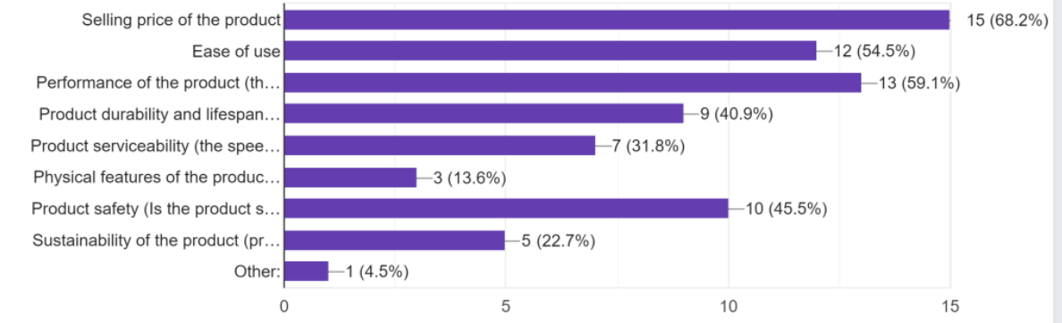
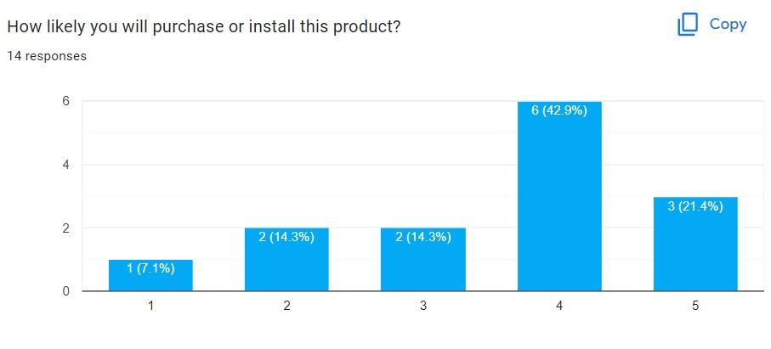
IoT based smart door lock system "Cypher"
Marawan ElDeib, Haneen AlJuhani, Ahmed Khudhair
Dr. Lo Yew Chiong
Protect Your Home, Anytime, Anywhere
Introducing our state-of-the-art Home Monitoring and Security System, designed to keep your home and belongings safe and secure at all times. With our advanced hardware and software components, such as motion and ultrasonic sensors, fingerprint sensor, and a smart lock, you'll never have to worry about intruders again.
Our system allows you to monitor your home in real-time through a mobile app, giving you remote access to your home at all times. In case of any alerts, notifications will be sent to you immediately, so you'll be informed even when you're not at home.
According to research studies, smart security systems have been found to effectively deter burglaries and improve response time in the event of a break-in. Upgrade to our system and enjoy the peace of mind that comes with knowing your home is safe and secure.
The research methodology for this project involves reviewing previous literature to gather information on similar projects and their issues.
The system was developed using PIR motion detection, ultrasonic sensor , fingerprint sensor and power management by using 12 volt reachable batteries to create a secure and energy-efficient system.
The performance of the system wil be tested by collecting data from the sensors using Arduino IDE, Firebase, and calculating
power consumption and the data will be analyzed to assess the system's security and energy efficiency.
Additionally, the system will be tested using the Android Studio emulator to ensure compatibility and functionality on mobile devices through a mobile application.
The results will be used to conclude whether the proposed system is effective in improving security and reducing energy consumption.
Majority of customers forget to lock their doors
Many customers live in apartments
Top concerns: cost, performance, ease of use
Our results show that we have successfully implemented several key features in our door lock system.
We were able to set up fingerprint recognition and control it remotely using a mobile application. We also implemented a power-saving feature by putting the microcontroller to sleep.
Additionally, we were able to send updates to a firebase database and receive them on the mobile application.
The system is also able to detect distance and motion and can open the door lock using the mobile application.
We also included a feature for login into the application using the customer’s fingerprint or face ID on his phone to remember the email and password encrypted.
Additionally, we added a buzzer as a warning if there was a suspicious motion detected near the system, and it will notify the customer in the application.
Users reported satisfaction with product performance.
Remote monitoring received positive feedback.
Half of users appreciated power saving feature.
Customers suggested a price range of 150-250 RM.
Our IoT Based Smart Door Lock System is not only designed to keep your home secure, but it also has a positive impact on society and the environment. With features such as power management and remote access control, it promotes energy efficiency and convenience for those with mobility issues. Additionally, the cost savings on electricity and added security benefits both homeowners and society as a whole. By choosing our system, you can rest easy knowing that your home is protected while also contributing to a sustainable future.

